Slide 1
Adopting a whole-system approach to transport decarbonisation
Dr Alex Penn &
Dr Naomi Bennett-Steele
University of Sussex
Sophie Morris Sandwell Council
On behalf of the WM Net Zero team

Slide 2
Key messages so far
Modelling shows that doubling bus use has minimal air quality impact, because bus travel is dwarfed by car journeys
Main bus health benefits come from extra activity and decreased noise
Also, if we want to prioritise health benefits, active travel is highly impactful
Cars are the main lever for CO2 and air pollution
To gain the benefits from public transport we need to use it to replace cars on a large scale and support active travel
We clearly need to look at the bigger picture

Slide 3
We need a whole-systems approach
Physical infrastructure (roads, bus and cycle lanes, tracks) just one part of transport system –social, political, economic, behavioural aspects crucial
Affects multiple things that matter to people, not just CO2 and air quality, but health, equitable access to jobs and services, liveability, economy
These are just as important to consider in policy as what we can measure and model quantitatively
This complexity means unexpected indirect effects and trade-offs are common
Use participatory systems mapping
Notes:
Physical infrastructure of transport systems connected to multiple, interacting social, economic, political, environmental and physical factors
Must deliver multiple outcomes: reduced carbon emissions; improved air quality; equitable access to services and liveable places
Interactions mean unexpected indirect effects outside what we normally consider
Trade-offs between outcomes often seen
"Carbon tunnel vision" – by trying to reduce carbon you can negatively affect other important outcomes
Need to understand interactions between ‘system factors’ so a complete picture can be used in decision making - participatory systems mapping

Slide 4
UK Personal Surface Transportation Participatory Systems Map
What it is, how it works, how people use it and why?
Workshops with transport providers; local authorities; NGOs; academics (Transition Network)
“Outcomes”:
Carbon,
NO2,
PM emissions;
Mobility Equity;
Connectivity;
Neighbourhood Self-Sufficiency
Factors from any domain that impact on or are impacted by these, and causal interconnections
Captures qualitative AND quantifiable - breadth of what matters to people, beyond previous models

Slide 5
Policy insights: Pulling out "downstream" effects of policy promoting EVs

Slide 6
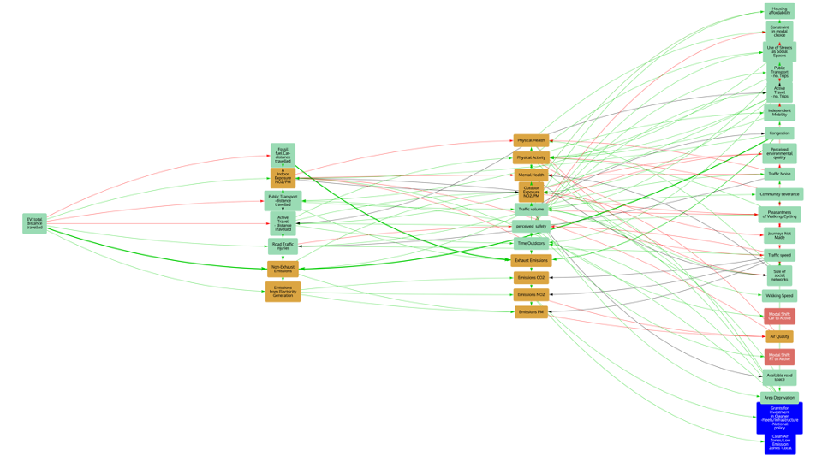
Indirect Effects of Policy Promoting EVs
Evidence of increasing reliance on EVs for short trips, increasing driving miles and congestion.
Multiple negative impacts:
•Pleasantness and liveability of neighbourhoods
•Community severance and local social networks
•Active travel and physical and mental health
•Public transport and access to affordable transport
•PM emissions from tyres and brakes and air quality
- Poorer communities were disproportionately affected
U.K. transport decarbonisation policies often focussed on EVs
Get beyond - EV "Tunnel Vision"
Notes:
U.K. transport decarbonisation policies are predominantly focussed on the uptake of electric vehicles (EVs)
Evidence is growing of increasing reliance on vehicles for short trips. More EVs > more private vehicles/miles and more congestion. Multiple negative impacts:
•Pleasantness and livability of neighbourhoods
•Community severance and local social networks
•Active travel and physical and mental health
•Public transport and access to affordable transport
•PM emissions from tyres and brakes and air quality
Poorer communities were disproportionately affected

Slide 7
Creating vicious cycles: Public Transport “Death Spiral”
Notes:
Make sure that equity point about public transport particularly buses is made

Slide 8
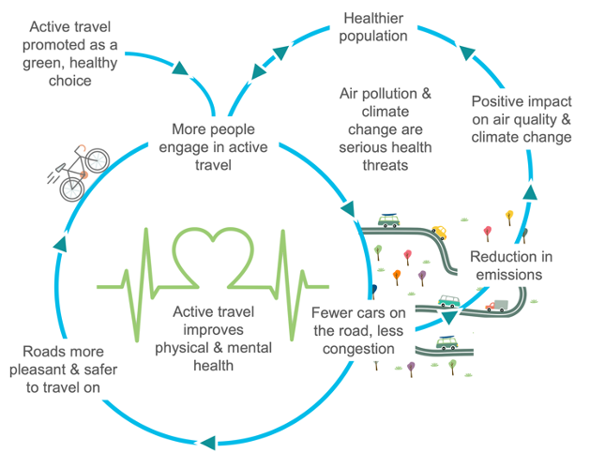
Systems approaches help us think practically about systems change
Negative impacts of congestion and the death spiral for public transport can be reversed –system lever
If we decrease congestion, health, liveability, social benefits etc all increase
And the more viable, reliable, affordable and accessible public transport becomes
Similar positive feedback loops exist for active travel, with fewer cars, wheeling becomes healthier and safer, people get fitter, and more people leave their cars for bikes/walking/wheeling
We can find and use system levers & feedback loops
Notes:
BUT The negative impacts of congestion from EVs on social and health outcomes and the death spiral for public transport can all work in the opposite direction
If we decrease congestion, we increase health and social benefits and we can reverse the death spiral into a virtuous cycle the more we reduce congestion, the more viable, reliable, affordable and accessible public transport becomes and the more people take buses. Leading to a drive towards buses and away from cars
Similar positive feedback loops exist for active travel, fewer cars, wheeling becomes healthier and safer, people get fitter and more people leave their cars for bikes/walking/wheeling

Slide 9
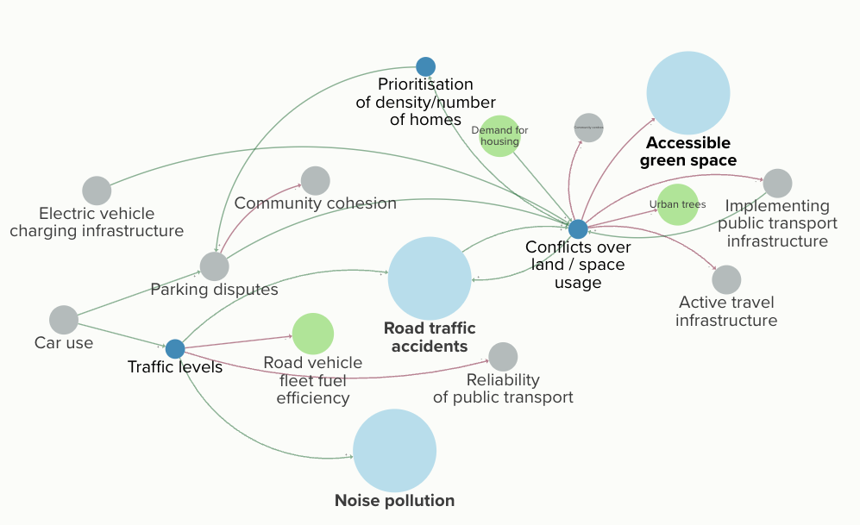
Where can we intervene to achieve multiple benefits?
Decisions about how we allocate space have widespread impacts and feed into multiple feedback loops
The demand for more housing and the influence of high car use can create unhealthy urban environments, squeezing out green space and active travel infrastructure
Notes:
(We can use systems approaches to identify interventions with multiple co-benefits)
Space use and well-designed public space lead to a whole host of positive co-benefits and can also make bus travel more viable by allowing reinforcing feedbacks to kick in

Slide 10
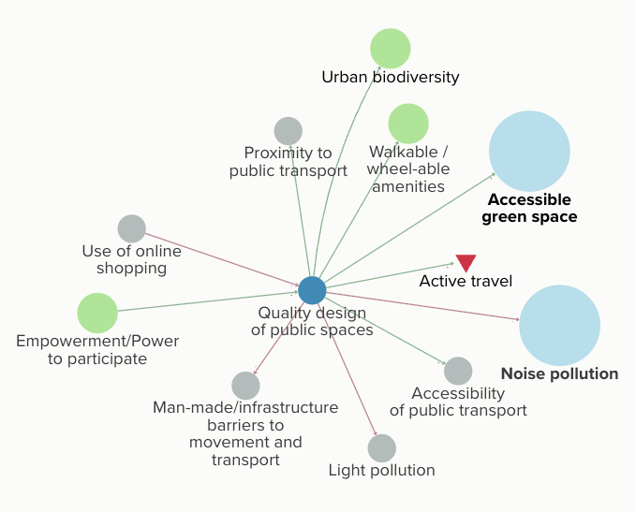
‘Good’ planning can unlock multiple benefits
The right kind of housing in the right places can make public transport more viable
Green space can reinforce active travel choices as well as reducing air pollution and having a direct benefit on mental health
Notes:
By expanding the network, the influence of these land/space use related factors on the factors of interest (in the LCAT model) can be shown. Additional exposures (Physical activity, Exposure to air pollution, green space use and injury) and health outcomes are closely related to the impacts of changes in these land/space use factors. The pathways shown may be partially reflected in the LCAT modelling, or may be supplementary.
Social cultural pathways and influence on health
Mold? – kids can’t have friends over, etc, stress

Slide 11
Summary + next steps
For air quality, carbon and health outcomes more bus travel won’t be effective unless we reduce cars simultaneously,
However, buses and active travel have health and equity benefits and are self-reinforcing once we get them over a certain threshold
Systems approaches allow us to make decisions that produce multiple important outcomes and are less likely to cause unexpected problems or trade-offs
We can use them to stress test interventions, identify what is most effective & understand barriers
Multiple possible interventions with positive co-benefits exist
How to make them work?

Slide 12
Dr Naomi Bennett-Steele &
Dr Alex Penn
University of Sussex
n.bennett-steele@sussex.ac.uk
alexandra.penn@sussex.ac.uk

