Slide 1
Co-developing Net Zero Transport Policy Scenarios to Quantify Future Emissions Changes in the West Midlands
WM-NETZERO@CONTACTS.BHAM.AC.UK
@WMNETZERO
WM-NET ZERO
A Health-centred Systems Approach towards Net-Zero: Transforming regional climate mitigation policies
Ye Hang, Yuli Shan, Suzanne Bartington, Zongbo Shi
University of Birmingham
Jian Zhong
University of Greenwich & University of Birmingham
Jenny Stocker
Cambridge Environmental Research Consultants
on behalf of the WM-Net Zero team

Slide 2
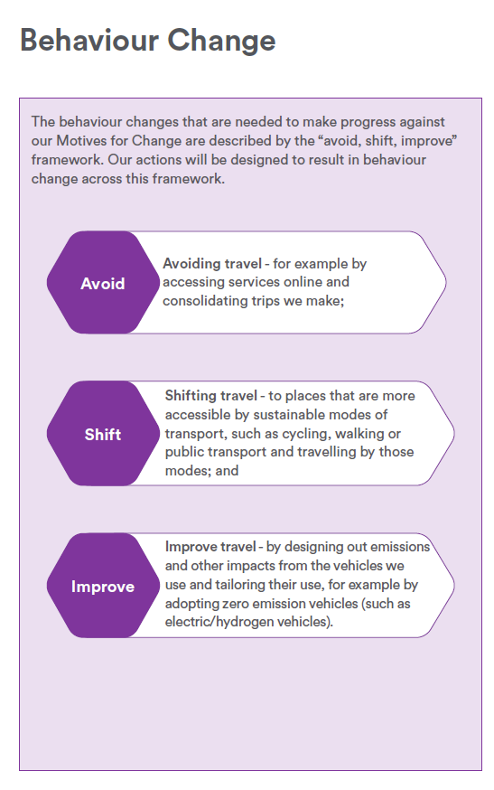
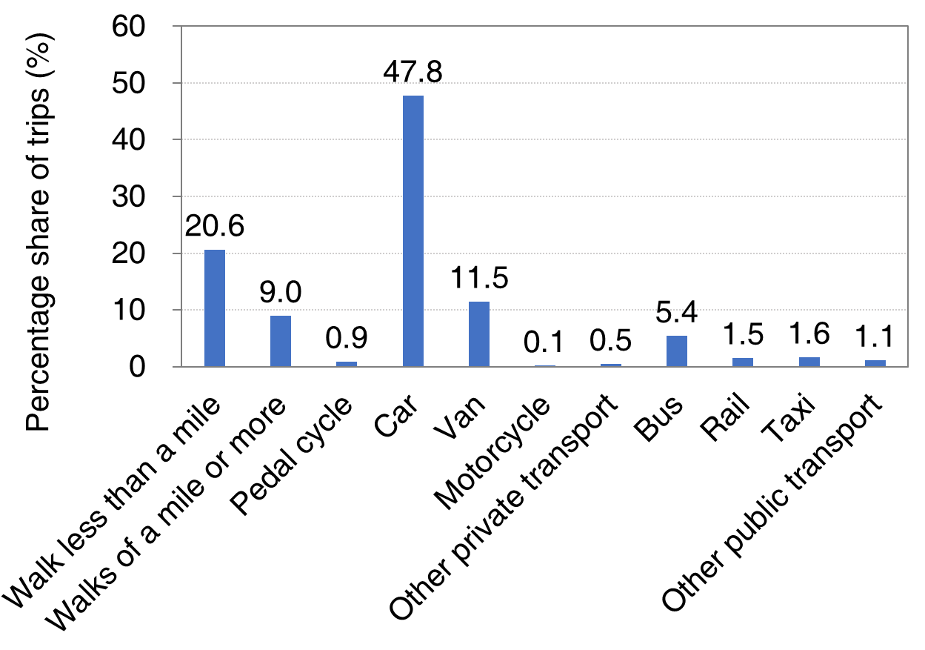
Background
Road transport emitted 3,587 kt of CO₂ emissions in 2022, accounting for 35.4% of the West Midlands’ total emissions (NAEI, 2024).
The West Midlands 5th Local Transport Plan (LTP) promotes the ‘Avoid-Shift-Improve’ framework to drive behaviour change for decarbonisation and deliver co-benefits for air quality.
Aim: To assess Net Zero transport policy scenarios and quantify their impacts on changes in CO₂ and air pollutant emissions.
Percentage share of trips (%)
Mode share of trips in non-London urban conurbations in 2023 (Source: National Travel Survey 2023).
Behaviour change based on Avoid–Shift–Improve framework (Source: West Midlands 5th Local Transport Plan).

Slide 3
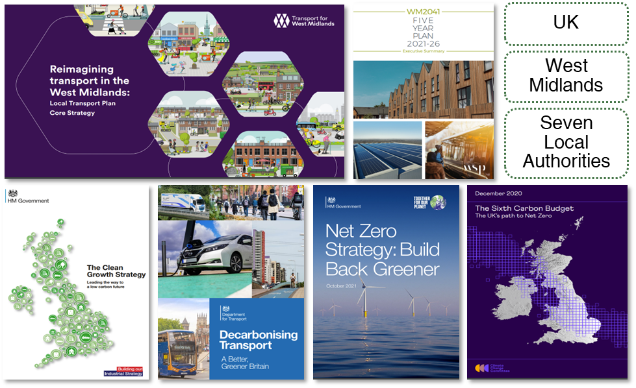
Method
1. Transport Documents Review
2. Transport Policy Scenarios
Category | Intended Action
Avoid Trips | Reduce car trips
 | Reduce car trips (considering increase in deliveries)
Modal Shift | Shortening trips
 | Increase in public transport
 | Increase in wheeling (e.g., cycling, e-scooter and e-bike)
Improve | Eco-driving
 | Electrify heavy vehicles (bus, HGV)
 | Electrify light vehicles (car, LGV)
Co-develop with stakeholders
3. Emissions Modelling
Alter traffic flow and fleet proportions based on scenarios
Defra’s Emissions Factors Toolkit (EFT version 12.0)
Business-as-Usual (BAU) year: 2036; Traffic data baseline year: 2019
Input: Traffic flow (vehicles/24h), speed (kph), road link length (km), fleet proportions by vehicle type (%)
Output: Annual emissions (CO₂, NO_{x}, PM₁₀, PM_{2.5})
Note:
CO₂ and NO_{x} : exhaust only; PM₁₀ and PM_{2.5} : exhaust + non-exhaust (i.e. tyre and brake wear, and road abrasion).
Traffic flow data source: TfWM

Slide 4
Net Zero transport policy scenarios
National target
WM target
Category | Item | Minimum change | Maximum change | Policy document relating to value (min. change) | Policy document relating to value (max. change)
Avoid Trips | Reduce car trips | 5% decrease in car trips for commuting, shopping and personal business | 20% decrease in car trips for commuting, shopping and personal business | CCC-Balanced NZ Pathway (by 2030) | 5th LPT (by 2030)
 | Reduce car trips (considering increase in deliveries) | 5% decrease in car trips for commuting, shopping and personal business; Increase in LGV trips for shopping | 20% decrease in car trips for commuting, shopping and personal business; Increase in LGV trips for shopping | CCC-Balanced NZ Pathway (by 2030) | 5th LPT (by 2030)
Modal Shift | Shortening trips | 30% shortening of shopping trips Shift car usage for shopping to bus Shift car usage for shopping to active travel | Reduce 50% of all trips by 50% Shift car usage for shopping to bus Shift car usage for shopping to active travel | CCC-Balanced NZ Pathway (by 2030) | 5th LPT (by 2030)
 | Increase in public transport | 30% increase in public transport: Shift car usage to 30% increase in bus Shift car usage to 30% increase in rail | Doubling public transport: Shift car usage to doubling bus Shift car usage to doubling rail | CCC-Balanced NZ Pathway (by 2030) | 5th LPT (by 2030)
 | Increase in wheeling | Shift car and bus usage to 200% increase in wheeling | Shift car and bus usage to 8 x increase in wheeling | CCC-Balanced NZ Pathway (by 2030) | 5th LPT (by 2030)
Improve | Eco-driving | 50% eco-driving | 75% eco-driving | CCC-Balanced NZ Pathway (by 2030) | 5th LPT (by 2030)
 | Electrify heavy vehicles (including bus, HGV) | 37% of HGVs are EVs; 48% of buses are EVs | 100% of HGVs are EVs; 100% of buses are EVs | National NZ Strategy (by 2035) | Five Year Plan 2021-2026 WM2041 (by 2041); WM BSIP 2024 (by 2036)
 | Electrify light vehicles (including car, LGV) | 53% of cars are EVs; 40% of LGVs are EVs | 100% of taxis are EVs Also assume that 100% of cars and LGVs are EVs | National NZ Strategy (by 2035) | Five Year Plan 2021-2026 WM2041 (by 2041) + assumption

Slide 5
Road Transport Emissions Reductions by Scenario (vs. 2019 Base)
CO₂: Improved fuel efficiency
NO_{x}: Reduced emission factors under tighter Euro standards; Declined diesel car share
33.8% in 2019
14.1% in 2036
~ 25%
＞75%
Non-exhaust (i.e. tyre and brake wear, and road abrasion) % of total emissions
PM₁₀: 77.5% in 2019
PM_{2.5}: 86.9% in 2019
＜25%
＜25%

Slide 6
Road Transport Emissions Reductions by Scenario (vs. 2036 BAU)
Minimum change
(National target)
~ 25%
~ 25%
53% of cars are EVs
40% of LGVs are EVs
Source: National NZ Strategy (by 2035)
＜12%
＜12%

Slide 7
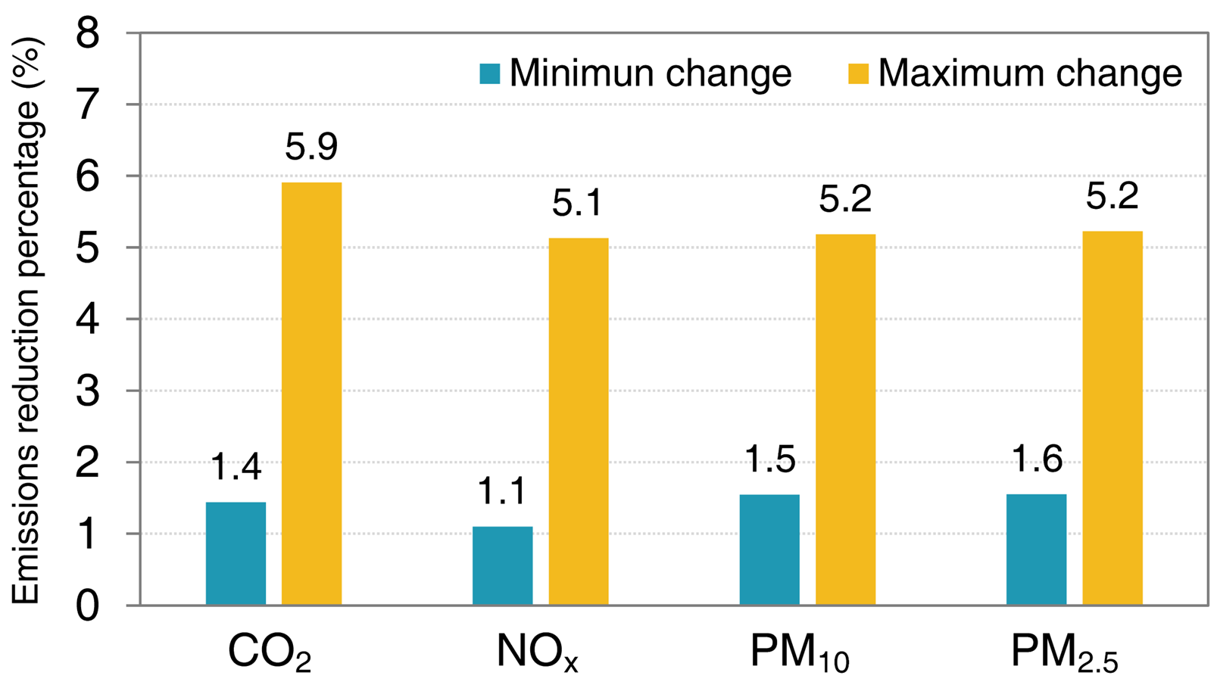
Road Transport Emissions Reductions Under the Combined Modal Shift and Improve Scenario (vs. 2036 BAU)
Increase in Bus Trips + Bus Electrification
Min: Shift car trips to achieve a 30% increase in bus trips, with 48% bus electrification.
Max: Shift car trips to double bus trips, with 100% bus electrification.
Emissions reduction percentage (%)
Percentage share of trips (%)
Min: car trips (-3.3%)
Max: car trips (-11.1%)
Road transport emission reductions (%) in 2036 under increased bus trips with bus electrification, relative to 2036 BAU.
2036 BAU emissions:
CO₂ = 3,445 kilotonnes
NO_{x} = 1,444 tonnes
PM₁₀ = 777 tonnes
PM_{2.5} = 416 tonnes
Mode share of trips in non-London urban conurbations in 2023 (Source: National Travel Survey 2023).
Notes:
We now turn to the combined “Modal Shift and Improve” scenario, which we prioritised following stakeholder discussions.
The idea is: reduce car trips by encouraging bus travel, while electrifying the buses.
We assessed two levels of ambition:
The minimum scenario assumes a 30% increase in bus trips with 48% bus electrification.
The maximum scenario doubles bus trips and assumes 100% bus electrification.
Under the most ambitious case, we observe about 5% reductions across all emissions compared with the 2036 Business-as-Usual.
This may seem limited, but it’s important to note:
Car use currently dominates travel, making up nearly 48% of trips.
In contrast, bus travel is only around 5%, so even doubling it still represents a relatively small mode share.

Slide 8
LSOA-Level Road Transport Emissions per km² in 2036
Scenario: Doubling Bus Trips with 100% Bus Electrification
Walsall
Wolverhampton
Sandwell
Dudley
Birmingham
Solihull
Coventry
Emissions hotspots are observed in motorways and the central urban areas.
Note:
LSOA: Lower layer Super Output Area.
Emissions are assigned to each LSOA by road length proportion and then dividing by the LSOA’s area (km²).

Slide 9
LSOA-Level Road Transport Emissions Reductions (vs. 2036 BAU)
Scenario: Doubling Bus Trips with 100% Bus Electrification
\\z
Walsall
Wolverhampton
Sandwell
Dudley
Birmingham
Solihull
Coventry
CO₂ reductions are concentrated in Birmingham.
PM_{2.5} show reductions in most areas apart from busy roads with lots of buses (non-exhaust emissions: increase in buses + heavier electric vehicles).
Dudley
Coventry
Dudley
Solihull
Solihull

Slide 10
Thank you for your attention!
WM-NETZERO@CONTACTS.BHAM.AC.UK
@WMNETZERO
WM-NET ZERO
A Health-centred Systems Approach towards Net-Zero: Transforming regional climate mitigation policies
Acknowledgement: Colleagues in WMCA, TfWM and Local Authorities in the WM.

